Slide 1
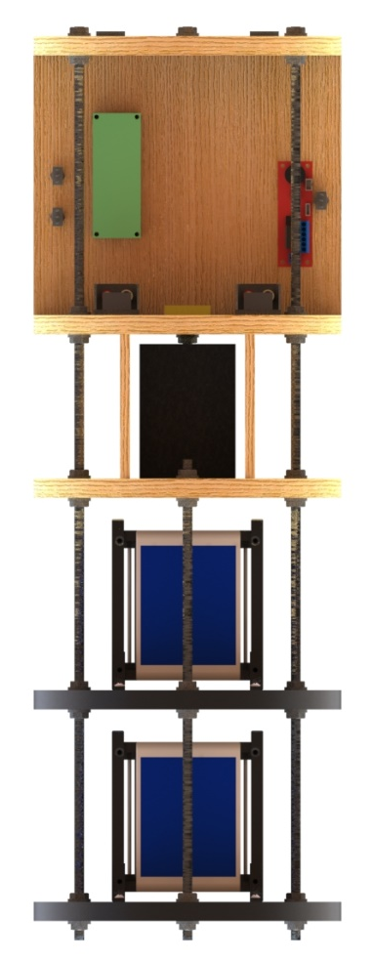
Electronics Overview
Electronics will consist of two similar and connected, but functionally separate bays.
The avionics bay, housing mission critical electronics
The payload bay which doubles as support for the satellites as well as providing extra weight
Payload bay connected to avionics bay below using bolts
Entire system integrated with rockets using U bolts below nose cone
Subject
Electronics and Payload

Slide 2
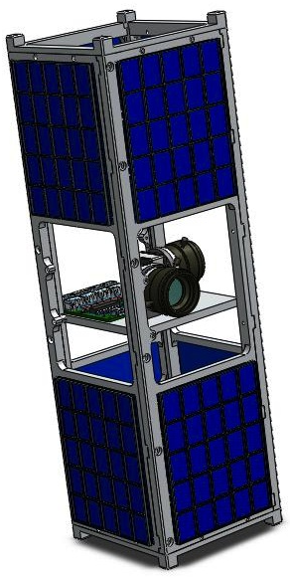
Payload - Travis
Rules:
Must be a minimum of ten lbs
Must be of scientific/engineering merit
Cannot interfere with rocket stabilization
CubeSat Payload:
Two teams each developed a 1U cube satellite, based at University of Sydney led by Dr. Xiaofeng Wu
We will be collaborating with winning teams to “field test” their design, see how it preforms under launch conditions, visiting in the coming months
Bonus creativity and points for international effort on extremely valid engineering payload
Both satellites expected to be around 2.2 lbs. a piece, coming to around 4.5 lbs total
To make up for this weight deficiency, we are creating a payload bay which will house the two satellites as well as provide additional weight.
Electronics and Payload

Slide 3
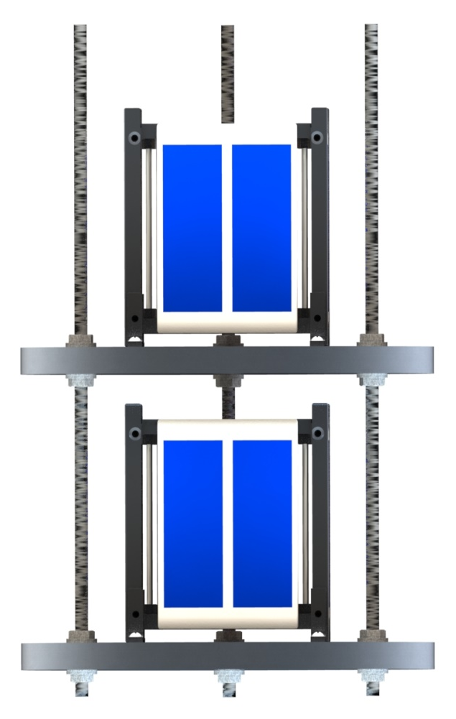
Satellite Bay
Design
Connected to avionics bay at the bottom, creating a full tower
The satellite bay will be two milled pieces of aluminum in place of wood slats to increase weight
Placed horizontally and connected by three all through bolts and lock nuts like avionics bay
Each satellite placed on a aluminum slat in separate “story”
At free hanging end, we will have padding to lend directional support during launch jostling
Electronics and Payload

Slide 4
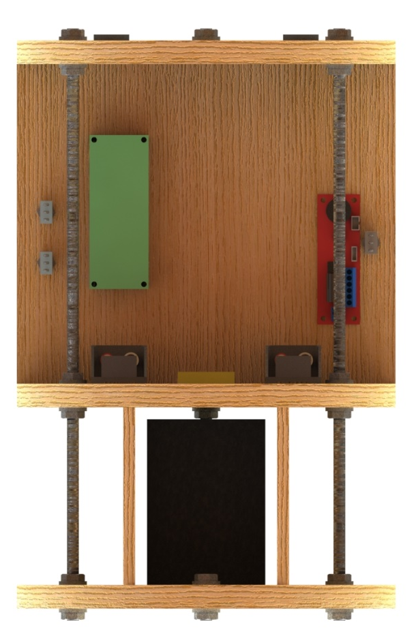
Avionics Mounting
Requirements/Rules
Our goal is to provide an entirely separate from the rocket and detachable tower that is able to accept a multitude of different sensors in different locations, while adhering to competition rules
Design
Avionics tower will be machined out of hard plywood
Three horizontal platforms, creating two sections, bottom for battery, top for primary electronics, holes drilled through platforms for wires
Top section has vertical board for all electronics to be mounted on for single
axis mindfulness
Two additional bottom section mounts for additional surface
Three all through threaded rods, secured with lock nuts at each platform
Connected to rocket body using U bolts at top
Electronics and Payload

